Slide 1
Presentation Notes
This entire deck, including demos but not the checkpoints, must be delivered in 10 minutes or less. Participants need time to do the actual lab.
Talking points are very brief. Even if you’ve seen the same slide in the past, take note of the new talking points.

Slide 3
Cross Platform Mobile Development with Xamarin
Code Labs

Slide 4

Mobile Development Trends
Native technologies
Native cross-platform
Device capabilities & perf
Silos per platform
Device capabilities & perf
Multi-platforms
Web technologies
Hybrid applications
Web standards based
Limited device access
Device capabilities
Limited perf
Notes:
Native technologies – Xcode, Android

Slide 5




C# cross-platform mobile: .NET + Xamarin
Native & Cross-Platform Mobile with C#
Share app logic across platforms
Native apps for Windows, iOS and Android devices using C#
Maximize code shared with Portable Class Libraries
Leverage existing C# skills
100% platforms’ APIs exposed
z
Native UI
Native UI
Native UI
C# + XIB
C# + AXML
C# + XAML
Shared
client app C# logic
“Anything you can do in Objective-C, Swift, or Java can be done in C# and Visual Studio with Xamarin”

Slide 6
Mobile DevOps Modules
1
Cross Platform Mobile Development with Xamarin
2
Continuous Integration using Visual Studio Team Services for Cross Platform Mobile Apps
3
Continuous Delivery for Cross-Platform Mobile Apps using Visual Studio Team Services and HockeyApp

Slide 7












Team Build (CI)
Test & Code Coverage
apk
Release
Management
with Approvals
git push
Bug Tracking
HockeyApp
Crash Reports
& Feedback
apk
UWP
Debugging in Visual Studio
Unit Test
HockeyApp
Update Manager
Emulator
apk
Simulator

Slide 8
Module 1
Visual Studio
Xamarin
Debugging
Unit Testing
Team Build (CI)
Test & Code Coverage
apk
Release
Management
with Approvals
git push
Bug Tracking
HockeyApp
Crash Reports
& Feedback
apk
UWP
Debugging in Visual Studio
Unit Test
HockeyApp
Update Manager
Emulator
apk
Simulator

Slide 9
Lab

Slide 10

Checkpoint
Notes:
Time: TBD

Slide 11
Wrap Up
Notes:
Time: TBD

Slide 13
Where can I find imagery?
A few great places to start…
Brand Central: A resource for information on the Microsoft brand
https://microsoft.sharepoint.com/teams/BrandCentral/
Microsoft News Center A great place for the latest and greatest
www.microsoft.com/en-us/news
Xbox Wire Media Assets library
http://news.xbox.com/media/
Featured Devices: PC, tablet and phone hardware imagery and marketing materials
https://www.featureddevices.com/
Presentation Resources: Presentation guidelines and PowerPoint templates
https://microsoft.sharepoint.com/teams/BrandCentral/Pages/Presentations.aspx
Respect intellectual property rights
Photography and graphics used in presentations, for both internal and external audiences, must be owned by Microsoft or licensed appropriately.
Microsoft has agreements in place with several stock providers. More information about approved stock providers and instructions for requesting licenses is available here: https://microsoft.sharepoint.com/teams/MediaAcquisition/Pages/knowledgeBase.aspx
Avoid intellectual property theft: Do not use photos or graphics copied from the web in presentations. When in doubt, consult with LCA http://lcaweb/CTP/Copyrights/Third-Party-Content-Use/Pages/default.aspx

Slide 14
Preferred text layout (no bullets)
Main topic 1: size 40pt
Size 20pt for the subtopics
Size 20pt for the subtopics
Main topic 2: size 40pt
Size 20pt for the subtopics
Size 20pt for the subtopics
Main topic 3: size 40pt
Size 20pt for the subtopics
Size 20pt for the subtopics

Slide 15
Preferred text layout (no bullets)
Main topic 1: size 40pt
Size 20pt for the subtopics
Size 20pt for the subtopics
Main topic 2: size 40pt
Size 20pt for the subtopics
Size 20pt for the subtopics
Main topic 3: size 40pt
Size 20pt for the subtopics
Size 20pt for the subtopics

Slide 16
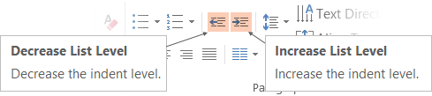
Adjusting list levels
Main topic 1: size 40pt
Size 20pt for the subtopics
Size 20pt for the subtopics
Main topic 2: size 40pt
Size 20pt for the subtopics
Size 20pt for the subtopics
Main topic 3: size 40pt
Size 20pt for the subtopics
Size 20pt for the subtopics
Use the “Decrease List Level” and “Increase List Level” tools on the Home Menu to change text levels.
Try this:
Place your cursor in any row of text to the left that says “Size 20pt for subtopics”
Next click the Home tab, and then on the “Decrease List level” tool. Notice how the line moves up one level.
Now try placing your cursor in one of the “Main topic…” lines of text. Click the “Increase List Level” tool and see how the text is pushed in one level
Use these 2 tools to adjust your text levels as you work

Slide 17
Bullet points layout with subtitle Subtitle
Example of a bulleted slide with a subhead
Set the slide title to “Sentence case”
Set subheads to “Sentence case”
Hyperlink style
www.microsoft.com

Slide 18
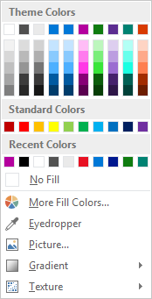
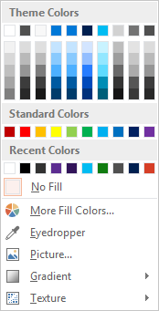
Slide palette info
The PowerPoint palette for this template has been built for you and is shown below. Avoid using too many colors in your presentation.
Select the 4th color from the left for subheads and 1st level non-bulleted text color, or wherever “color” text is preferred over the default black/white text
Accent colors 1-6 – (6 Theme Colors to the far right)
Text
Dark 2
Accent 1
Accent 2
Accent 3
Accent 4
Accent 5
Accent 6
Use Accent 1 as the main accent color. Use Accent 2 and Accent 3 when additional colors are needed.
Use Accents 4-6 sparingly – only when more colors are necessary.

Slide 19
Charts
For content: Type is what articulates the message. Text doesn’t need to be bulleted. Text size can reinforce and impact.

Slide 20
Charts
For content: Type is what articulates the message. Text doesn’t need to be bulleted. Text size can reinforce and impact.

Slide 21
Table
Column 1 | Column 2 | Column 3 | Column 4 | Column 5
Text | Text | Text | Text | Text
Text | Text | Text | Text | Text
Text | Text | Text | Text | Text
Text | Text | Text | Text | Text
Text | Text | Text | Text | Text
Text | Text | Text | Text | Text
Text | Text | Text | Text | Text
Text | Text | Text | Text | Text
This is a content box, always 24pts and sentence case.

Slide 22
Diagram with text
This is a content box, always 24pts and sentence case.
Windows Style App
<audio src=“…”>
<video src=“…”>
Windows Runtime (WinRT)
Playback/Preview
(Media Engine)
Capture
(Capture Engine)
Transcode
Streaming
(Sharing Engine)
Media Foundation
Audio/Video
Source
Video
Decoder
Video
Effect 1
Video
Effect N
Video
Encoder
Audio/Video
Sink
Audio
Decoder
Audio
Effect 1
Audio
Effect N
Audio
Encoder

Slide 23
Diagram without text
New Windows 8 app
<audio src=“…”>
<video src=“…”>
Windows Runtime (WinRT)
Playback/Preview
(Media Engine)
Capture
(Capture Engine)
Transcode
Streaming
(Sharing Engine)
Media Foundation
Audio/Video
Source
Video
Decoder
Video
Effect 1
Video
Effect N
Video
Encoder
Audio/Video
Sink
Audio
Decoder
Audio
Effect 1
Audio
Effect N
Audio
Encoder

Slide 24
Video

Slide 25
Demo
Speaker name

Slide 26
Photo layout 1
Notes:
Use developer type photo.

Slide 27
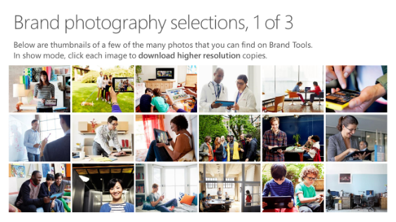
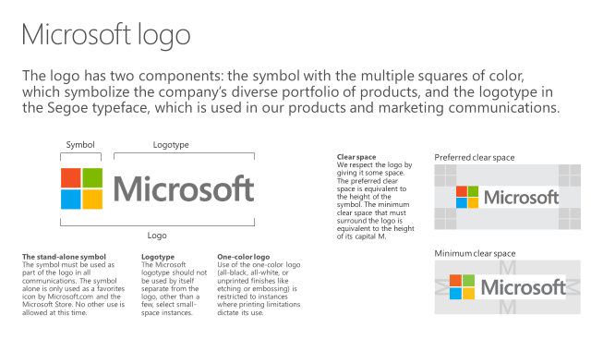
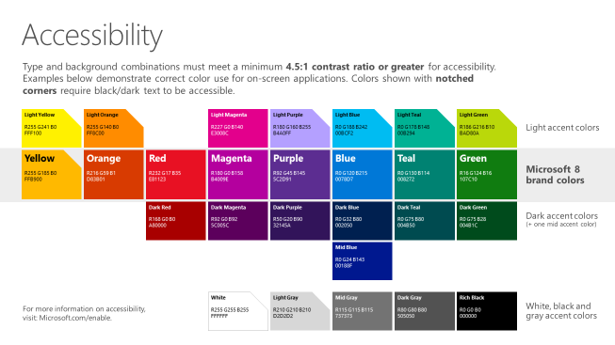
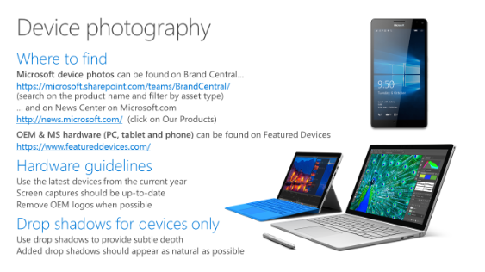
Microsoft brand guidelines
Looking for more slide resources?
Brand guidelines for PowerPoint templates is a separate slide deck that provides an overview of the Microsoft brand, guidelines, resources, tips and much more.
A few of the slides are shown at right.
Download from: https://microsoft.sharepoint.com/teams/BrandCentral/Pages/Presentations.aspx

Slide 28
Section title

Slide 29
Section title
Notes:
Make text black in master.

Slide 30
“If you could only sense how important you are to the lives of those you meet; how important you can be to the people you may never even dream of. There is something of yourself that you leave at every meeting with another person.”
FRED ROGERS

Slide 31
Software code slide
This slide layout uses Consolas, a monotype font which is ideal for showing software code.

Slide 32
Notes (hidden)
Some speakers at Microsoft like to use this slide for hidden “notes slides”.
Delete it if you don’t want to use it.
NEXT: <next slide title>

Slide 33
Call to Action
Use this slide to list resources, white papers, videos and links.
Let attendees know their next step after seeing this session.
Re-visit Build on Channel 9.
Continue your education at Microsoft Virtual Academy online.

Slide 34
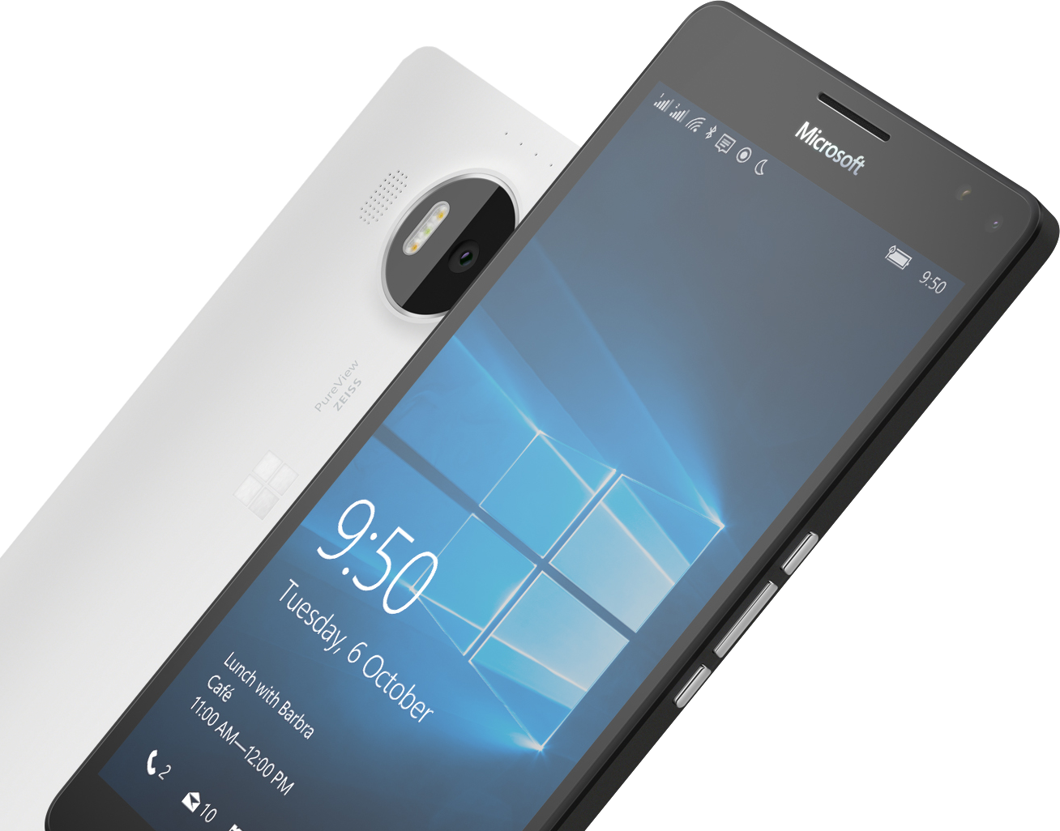
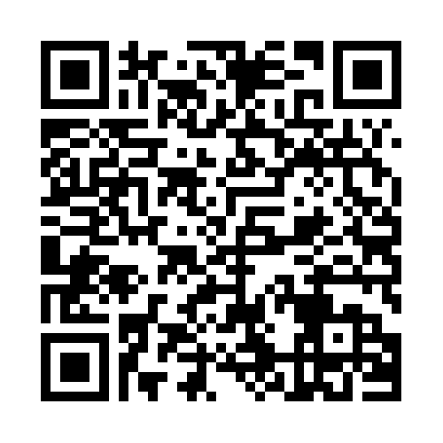

Please Complete An Evaluation Form Your input is important!
Required Slide
*delete this box when your slide is finalized
SAMPLE
or
Notes:
Update phone image to a Microsoft phone.

Slide 35
Evaluate this session
Required Slide
*delete this box when your slide is finalized
Speakers: This slide will be updated during the scrub process with a unique QR code. Attendees scan the QR code to access the eval for your session.
SAMPLE
Notes:
Speakers: Please note this slide will be updated with your session’s QR code during the scrub process which is outlined on side 3. Attendees can scan the QR code for access to your session’s eval.

Slide 37
Presentation title goes here
Speaker name
Title

Slide 38
Preferred text layout (no bullets)
Main topic 1: size 40pt
Size 20pt for the subtopics
Size 20pt for the subtopics
Main topic 2: size 40pt
Size 20pt for the subtopics
Size 20pt for the subtopics
Main topic 3: size 40pt
Size 20pt for the subtopics
Size 20pt for the subtopics

Slide 39
Bullet points layout with subtitle Subtitle
Example of a bulleted slide with a subhead
Set the slide title to “Sentence case”
Set subheads to “Sentence case”
Hyperlink style
www.microsoft.com

Slide 40
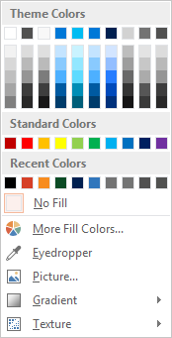
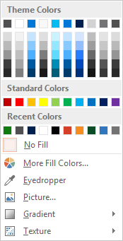
Slide palette info
The PowerPoint palette for this template has been built for you and is shown below. Avoid using too many colors in your presentation.
Accent colors 1-6 – (6 Theme Colors to the far right)
Accent 1
Accent 2
Accent 3
Accent 4
Accent 5
Accent 6
Use Accent 1 as the main accent color. Use Accent 2 and Accent 3 when additional colors are needed.
Use Accents 4-6 sparingly – only when more colors are necessary.

Slide 41
Charts
For content: Type is what articulates the message. Text doesn’t need to be bulleted. Text size can reinforce and impact.

Slide 42
Charts
For content: Type is what articulates the message. Text doesn’t need to be bulleted. Text size can reinforce and impact.

Slide 43
Table
Column 1 | Column 2 | Column 3 | Column 4 | Column 5
Text | Text | Text | Text | Text
Text | Text | Text | Text | Text
Text | Text | Text | Text | Text
Text | Text | Text | Text | Text
Text | Text | Text | Text | Text
Text | Text | Text | Text | Text
Text | Text | Text | Text | Text
Text | Text | Text | Text | Text
This is a content box, always 24pts and sentence case.

Slide 44
Diagram with text
This is a content box, always 24pts and sentence case.
Windows Style App
<audio src=“…”>
<video src=“…”>
Windows Runtime (WinRT)
Playback/Preview
(Media Engine)
Capture
(Capture Engine)
Transcode
Streaming
(Sharing Engine)
Media Foundation
Audio/Video
Source
Video
Decoder
Video
Effect 1
Video
Effect N
Video
Encoder
Audio/Video
Sink
Audio
Decoder
Audio
Effect 1
Audio
Effect N
Audio
Encoder

Slide 45
Diagram without text
New Windows 8 app
<audio src=“…”>
<video src=“…”>
Windows Runtime (WinRT)
Playback/Preview
(Media Engine)
Capture
(Capture Engine)
Transcode
Streaming
(Sharing Engine)
Media Foundation
Audio/Video
Source
Video
Decoder
Video
Effect 1
Video
Effect N
Video
Encoder
Audio/Video
Sink
Audio
Decoder
Audio
Effect 1
Audio
Effect N
Audio
Encoder

Slide 46
Video

Slide 47
Demo
Speaker name

Slide 48
Photo layout 1
Notes:
Use developer type photo.

Slide 49
“If you could only sense how important you are to the lives of those you meet; how important you can be to the people you may never even dream of. There is something of yourself that you leave at every meeting with another person.”
FRED ROGERS

Slide 50
Section title

Slide 51
Section title
Notes:
Make text black in master.

Slide 52
Software code slide
This slide layout uses Consolas, a monotype font which is ideal for showing software code.

Slide 53
Notes (hidden)
Some speakers at Microsoft like to use this slide for hidden “notes slides”.
Delete it if you don’t want to use it.
NEXT: <next slide title>

Slide 54
Call to Action
Use this slide to list resources, white papers, videos and links.
Let attendees know their next step after seeing this session.
Re-visit Build on Channel 9.
Continue your education at Microsoft Virtual Academy online.

Slide 55
Please Complete An Evaluation Form Your input is important!
Required Slide
*delete this box when your slide is finalized
SAMPLE
or
Notes:
Update phone image to a Microsoft phone.

Slide 56
Evaluate this session
Required Slide
*delete this box when your slide is finalized
Speakers: This slide will be updated during the scrub process with a unique QR code. Attendees scan the QR code to access the eval for your session.
SAMPLE
Notes:
Speakers: Please note this slide will be updated with your session’s QR code during the scrub process which is outlined on side 3. Attendees can scan the QR code for access to your session’s eval.

Slide 57
Notes:
Dark gray background.

